Slide 1


SOMERSET PURPOSE
Somerset Academy, Inc. promotes a transformational culture that maximizes student achievement and the development of accountable, global learners in a safe and enriching environment that fosters high-quality education.
S - Set high expectations
O - Objective
M - Meaningful curriculum
E - Effective
R - Resourceful and responsible life long learners
S - Scholars who achieve proficiency and beyond
E - Evaluate continuously and use data to drive curriculum
T - Teachers who are highly qualified

Slide 2

DO NOT. . .
“Hang out” in the stairwells or on the second floor during lunch.
Chew gum. DO NOT BRING GUM!
Go on the basketball court with a skateboard!
Use the elevator without approval from the office.
Leave campus if you are a Middle Schooler, Freshman or Sophomore (Except for DE students)
Allow an underclassmen in your vehicle without prior permission, or you will lose all privileges for the remainder of the school year.
Throw anything off the balcony.
Throw anything from the ground level to the 2nd floor.
Eat or carry food over the basketball court or turf field
Litter or leave garbage around at lunch
Hang out by the wavy wall side or behind the basketball court bleachers
Hang on or grab the basketball nets/rims
Playing “keep away” = a detention
Yoga pants/ leggings/ are not allowed. Not even during dress down days. Dress code violations earn detentions
You are not to go to the Deans’ office during class to argue a detention. You will be turned away.

Slide 3
Discipline
Discipline is applied with mutual respect in a firm, fair , reasonable and consistent manner.
Preventive Morning announcements, Teacher and School's Rules & Expectations
Supportive Warnings for students to get back on task. Email notification to parents
Corrective Weekly Monday Detentions, Monthly Saturday Detentions

Slide 4
Somerset College Prep Discipline Matrix
*Warnings* Do Not apply to all discipline. Teacher & Staff discretion
DETENTION
SATURDAY DETENTION
SUSPENSION including DISMISSAL
3:50 to 4:50pm
Classroom Disruption
Disruptive Conduct
Chewing Gum
Bus Violation
Disrespect for others
Disrespect for property
Littering during lunch
Electronic Confiscation
Public Display of Affection / P.D.A
Profane Obscene Abusive Language
Running in the Halls
Spray used in the Restrooms
Tardy to Class
Tardy to School ( 3 late arrivals non bus rider)
9:30 to 12:30pm
Horseplay
Missed Detention
Multiple Detentions
Disruptive Conduct
Bus Violation
Skipping = 2 Saturday Detentions, Referral & 9 week Behavior Probation Contract
Cheating = 3 Saturday Detentions, Referral & Behavior Probation Contract
Excessive Detentions / Unserved Detention
Theft
False or Misleading Info
Open Defiance of Authority
Vaping
Physical Altercation
Fighting or Attempting to Fight
Assault / Intimidation Threat of Student
Weapons
Other Major Misconduct

Slide 5
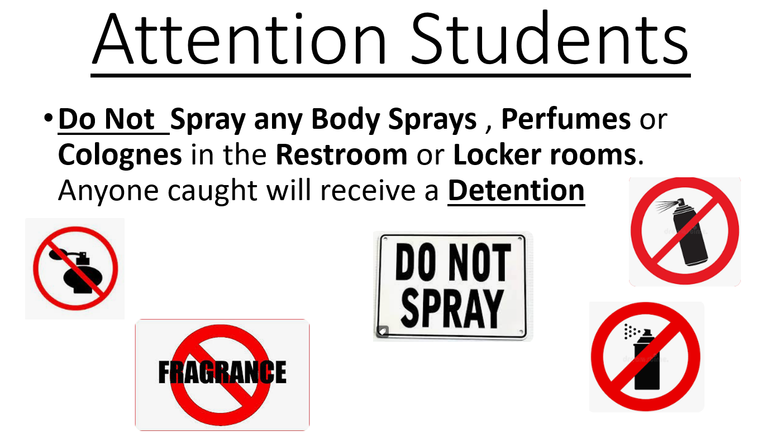

Slide 6

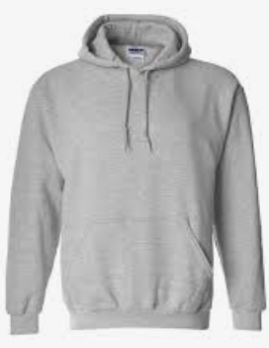
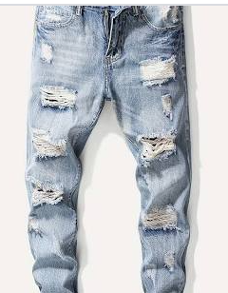
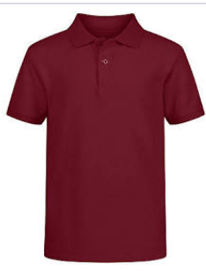
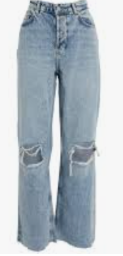
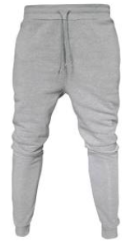
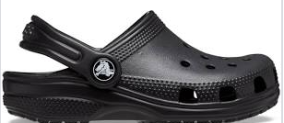
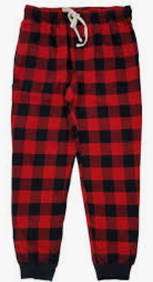
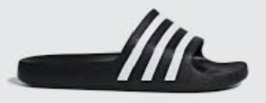
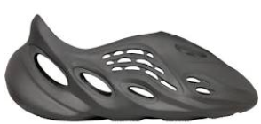
Dress Code Violations (Do Not Wear)
Ripped or Frayed Jeans
Non - Somerset, Hoodies or Polos
Crocs, Slides & Foam Runners
Sweatpants, Joggers, Yoga pants, tights or Pajama pants

Slide 7
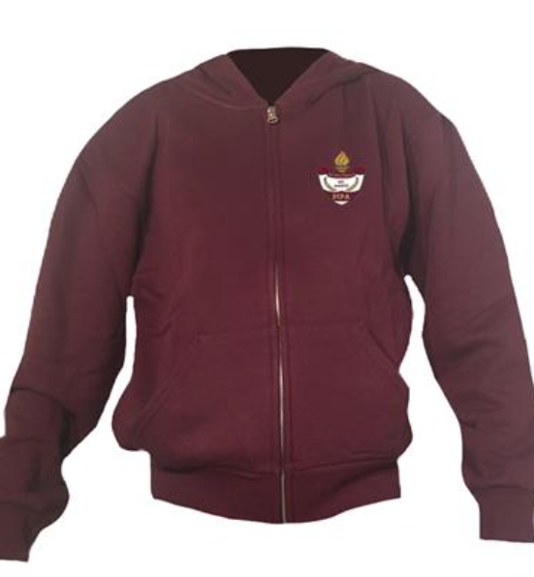
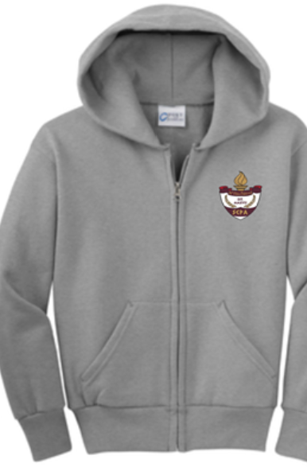
Dress Code Violations
A Somerset College Prep shirt must be worn underneath a zip up Hoodie or Jacket.
Exceptions would include
House Shirts on Thursday's
School Friday Shirts
Club Shirts
School Athletic apparel for game days.
Anyone not in compliance will be given a Dress Code Violation according to our Discipline Matrix.

Slide 8
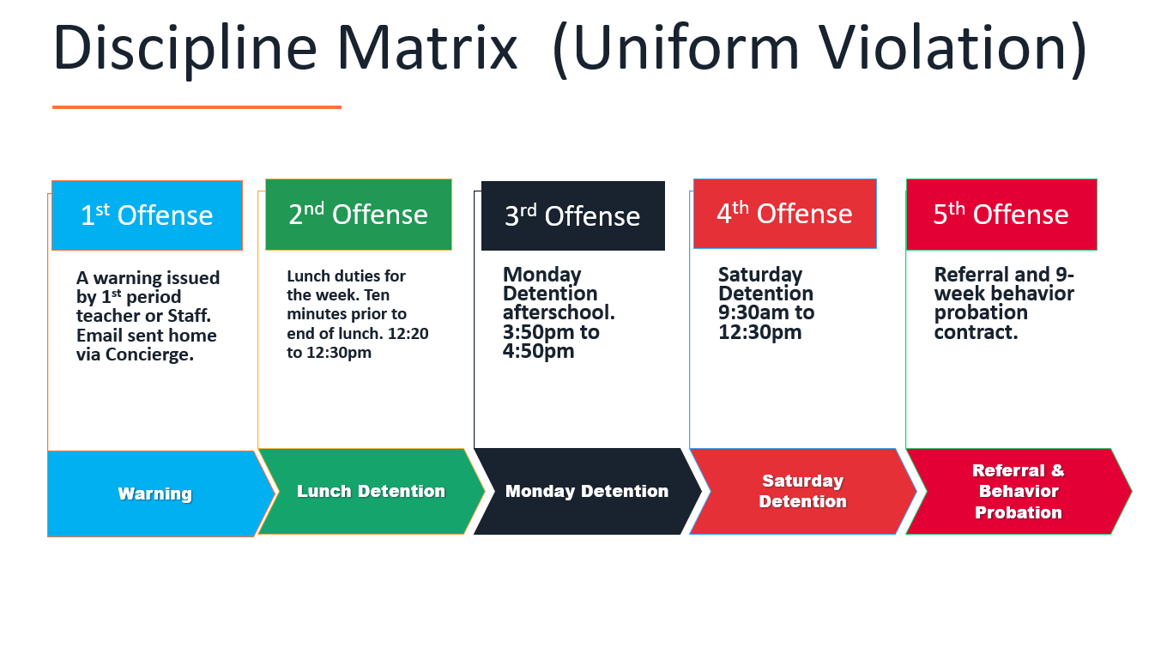

Slide 9
Dress Code (What can I wear)
School Appropriate Attire
OK
Solid Color Shorts (Fingertip length or longer)
Denim, Khaki, Cargo & Jean Shorts
House Shirts
Club Shirts
Skorts, Capris Any color
Not OK
Spandex Material
Rips , Tears or Frays
Sweatpants, Yoga pants
Tank tops
Leggings
Bottoms with print or derogatory slogans

Slide 10
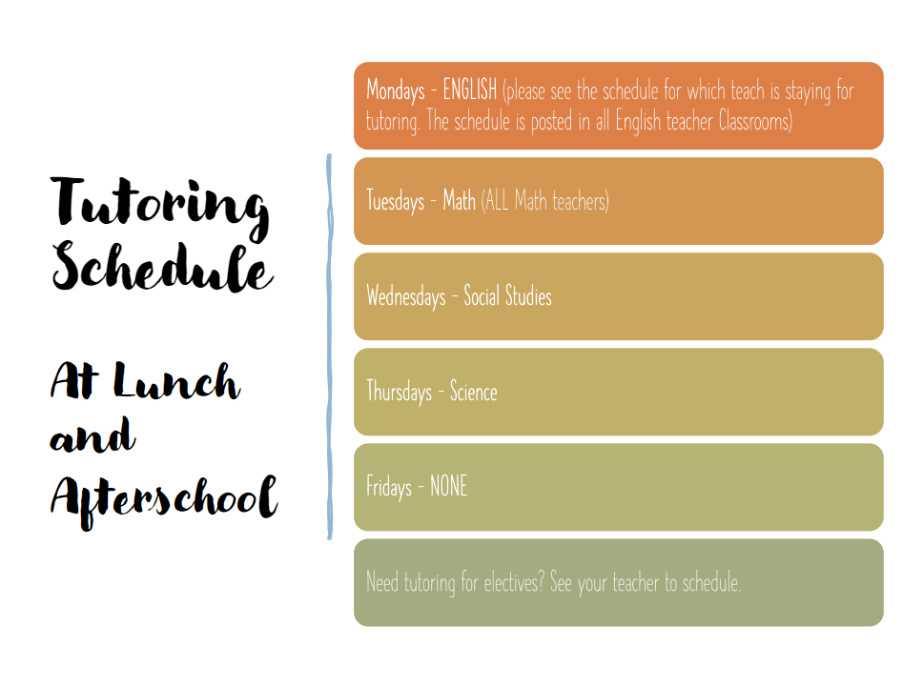

Slide 11

Tardy—being late to class.
Being tardy to periods 2, 3, or 4 is accompanied by a detention.
Period 2, 3, 4 teachers write & submit the detention.
Being tardy to 1st period is a detention if you are a bus rider and your bus was on time.
Being tardy to 1st period and you are not a bus rider is a detention for every 3rd occurrence.
*Does not apply to excused tardies.

Slide 12
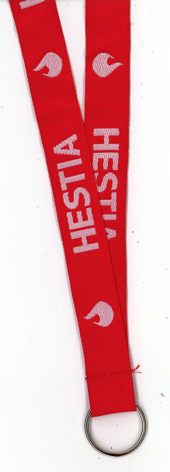
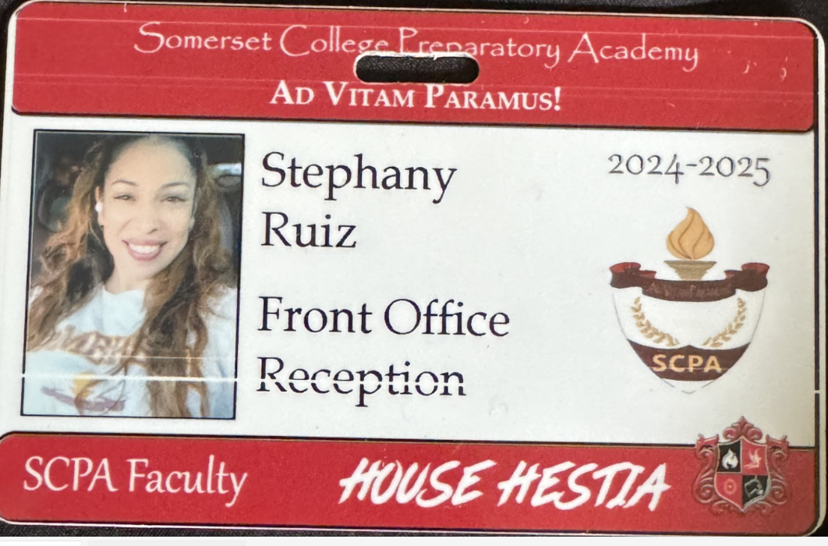
Lanyards and IDs are a Mandatory
Part of your uniform
Needs to be worn around your neck, all day/everyday during school hours
If asked, STOP and put on ID
No Lanyard and ID will result in a dress code violation.
Purchase in Front Office
Lanyard $3
ID $2 (Cash Only)

Slide 13
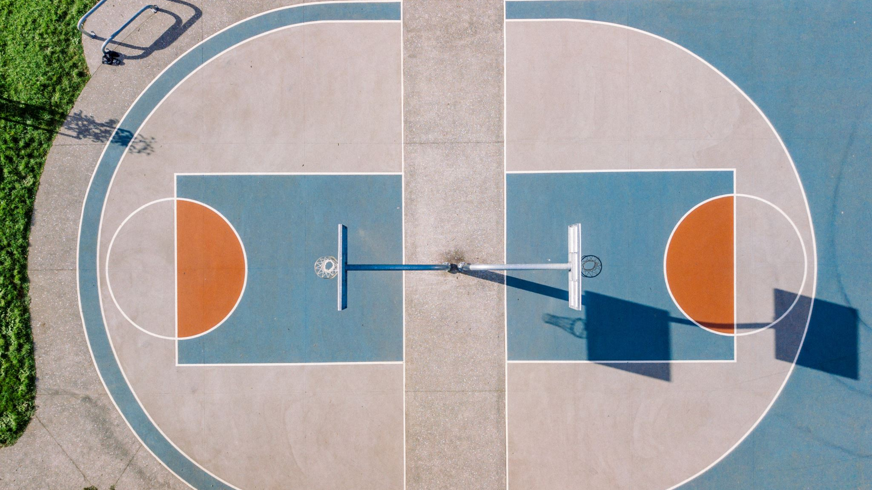
on basketball courts OR turf without a staff member present
(This means mornings & after school too.)
NO Playing ANY SPORTS

Slide 14
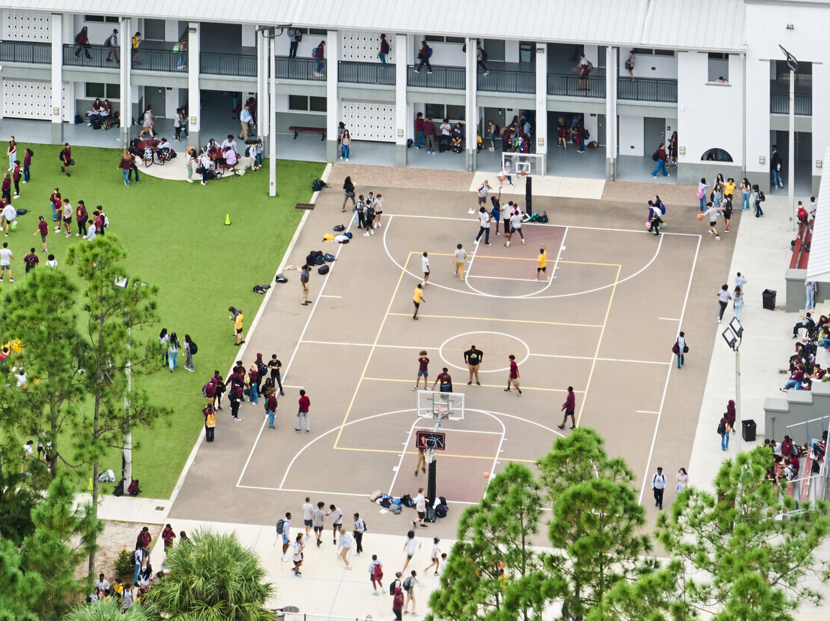
NO FOOD or drink ON THE COURT

Slide 15
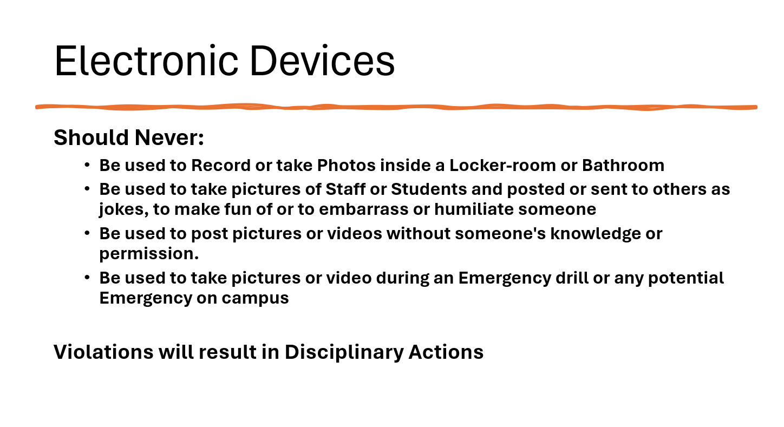

Slide 16
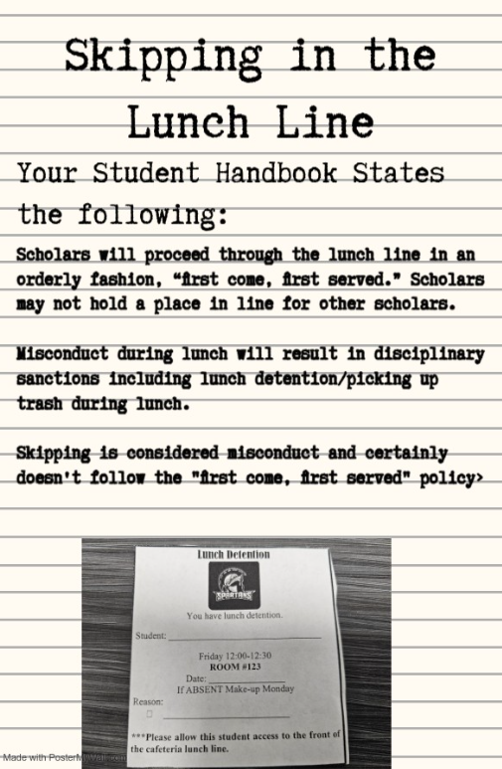

Slide 17
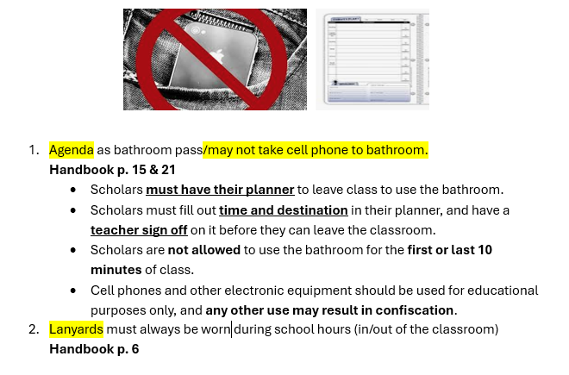

Slide 18

Tell an adult in our school!

Slide 19

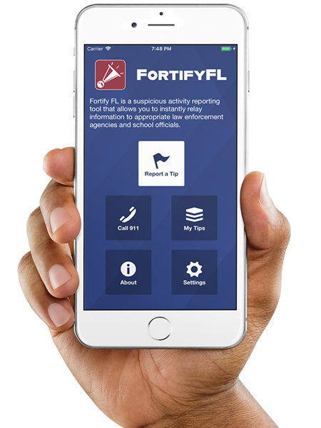
Anonymous Reporting App

Slide 20
ATTENTION STUDENTS!!
Did you know that the Florida Department of Law Enforcement and the Florida Department of Education created an anonymous reporting App that allows you to instantly send information about suspicious activity to local law enforcement and school officials?

Slide 21
WHY?
It is important to always remember that If You See Something, Say Something! With FortifyFL, you can easily submit information about potential crimes or threats which will immediately be forwarded to law enforcement and designated school personnel.

Slide 22
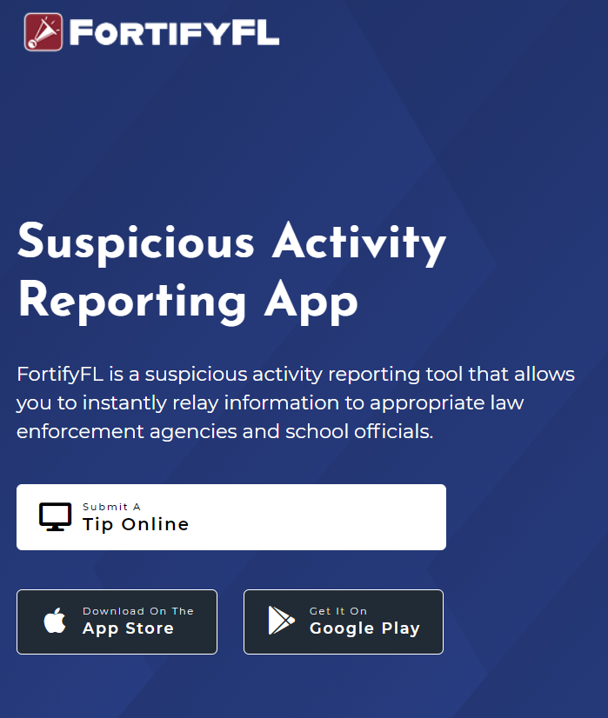
HOW DO I SUBMIT A TIP?
You can submit a tip from any computer at: https://getfortifyfl.com/

Slide 23
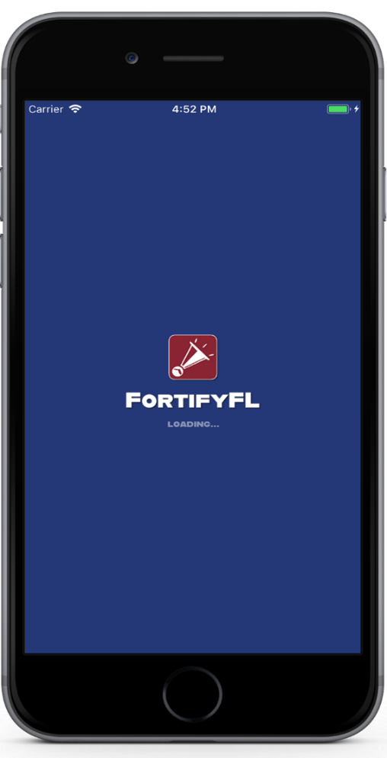

HOW DO I SUBMIT A TIP?
You can also submit a tip using your cell phone. Download the FortifyFL App on your mobile device.

Slide 24
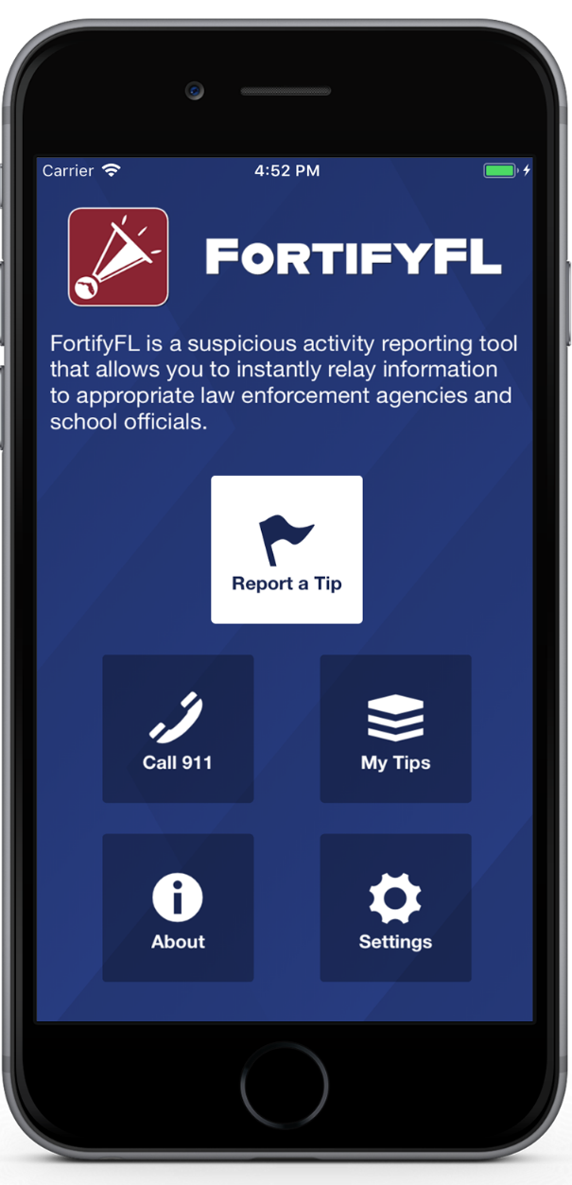
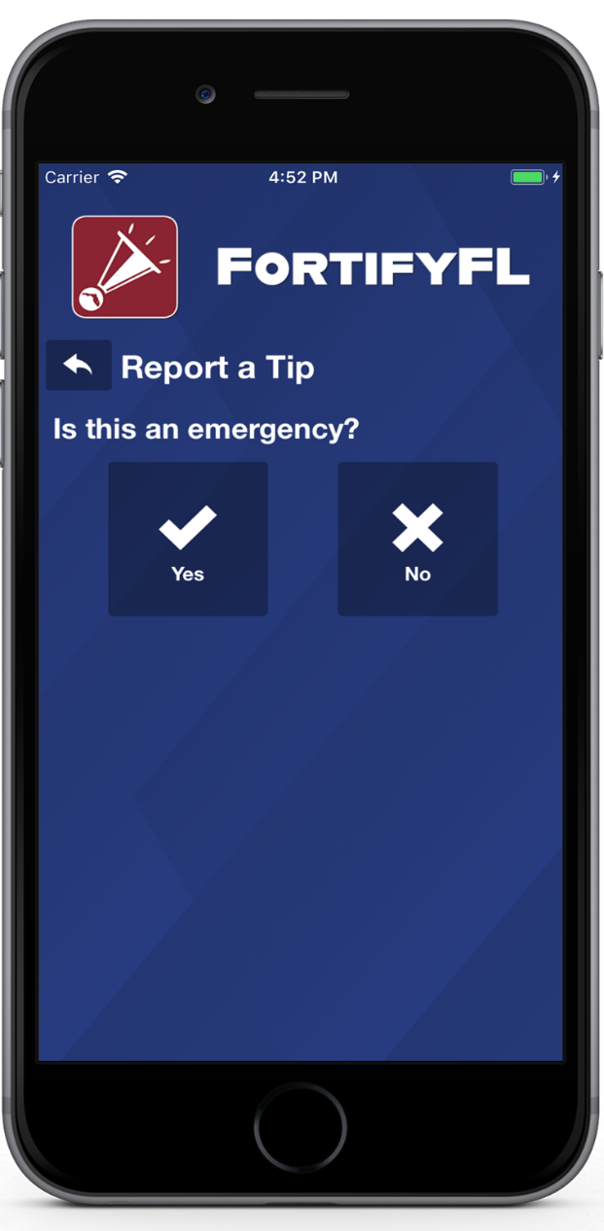
HOW DO I SUBMIT A TIP?
Click “Report a Tip,” and indicate if it is an emergency

Slide 25
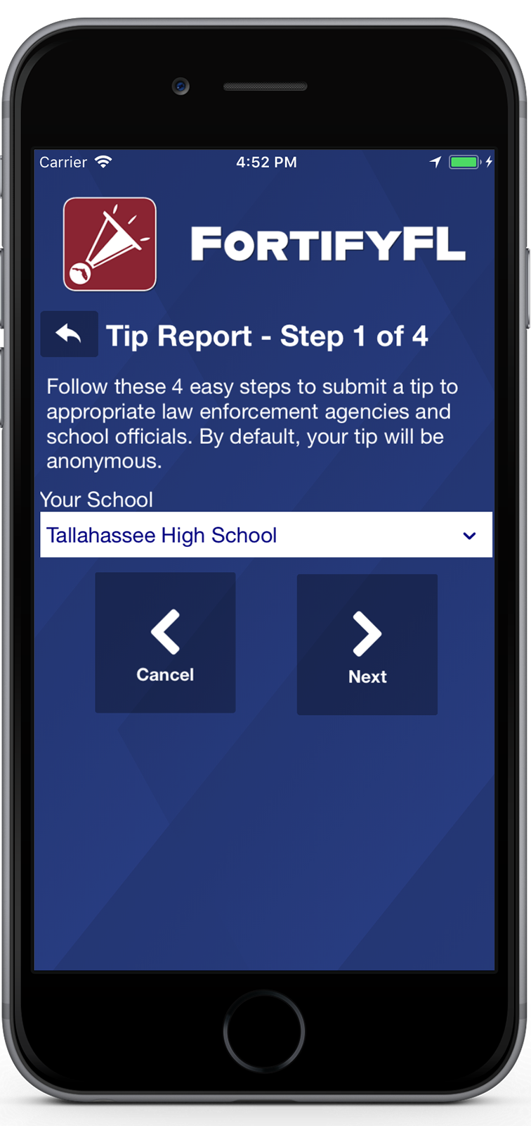
HOW DO I SUBMIT A TIP?
Step 1: Select Your School

Slide 26
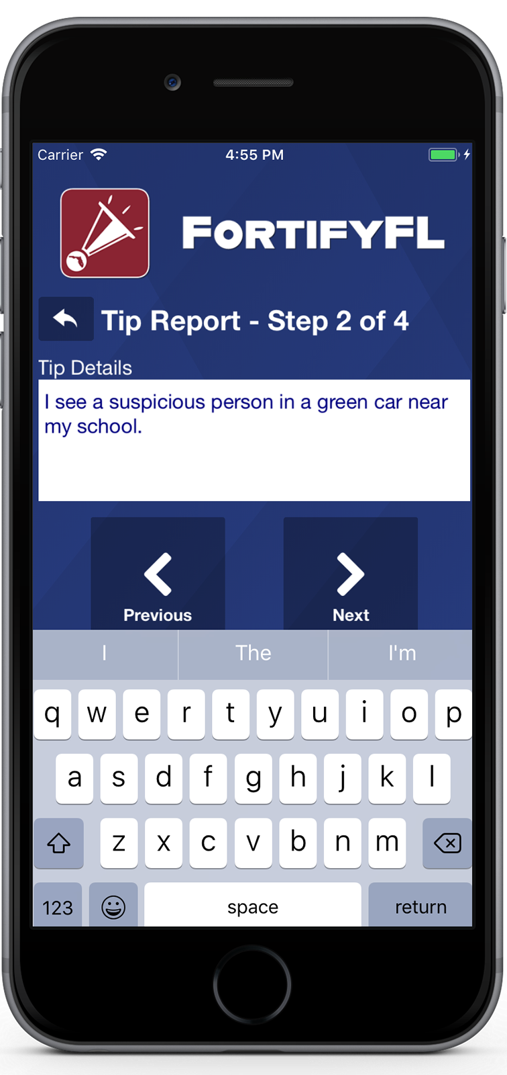
HOW DO I SUBMIT A TIP?
Step 2: Provide Your Tip

Slide 27
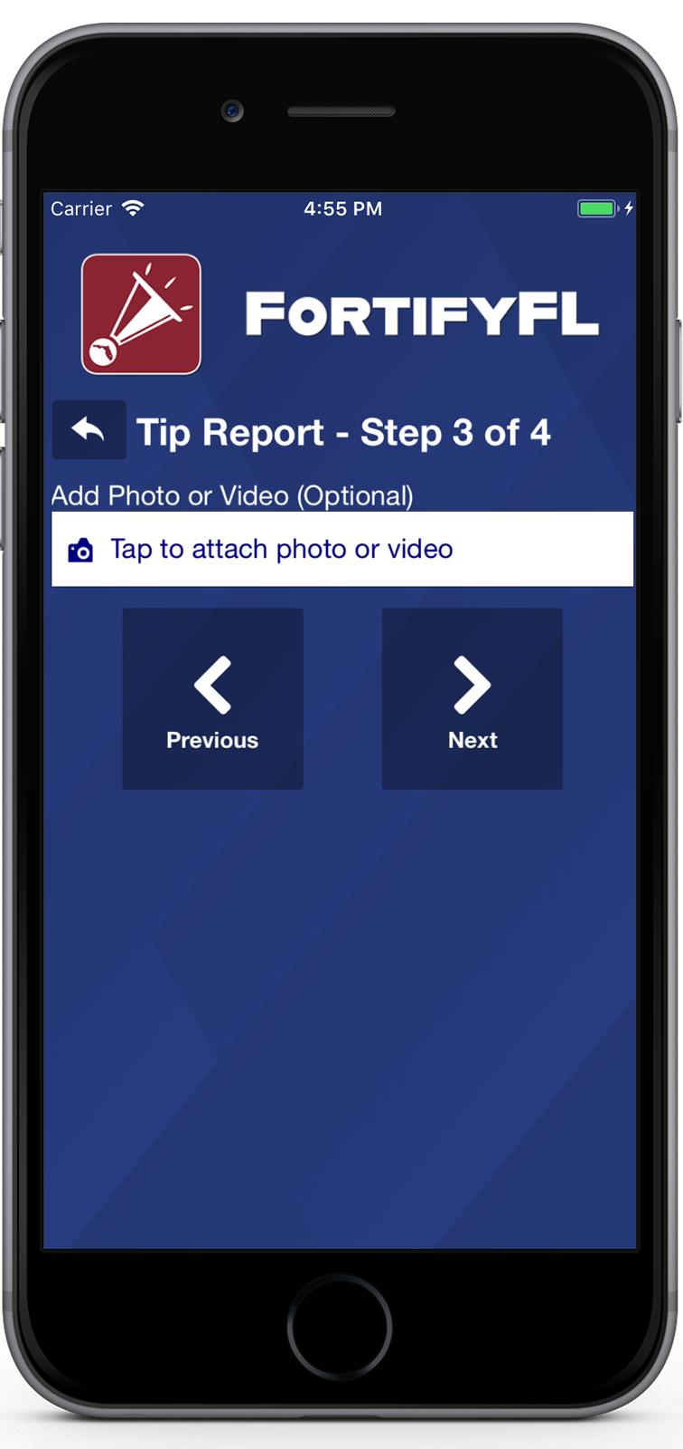
HOW DO I SUBMIT A TIP?
Step 3: Attach an Optional Photo or Video

Slide 28
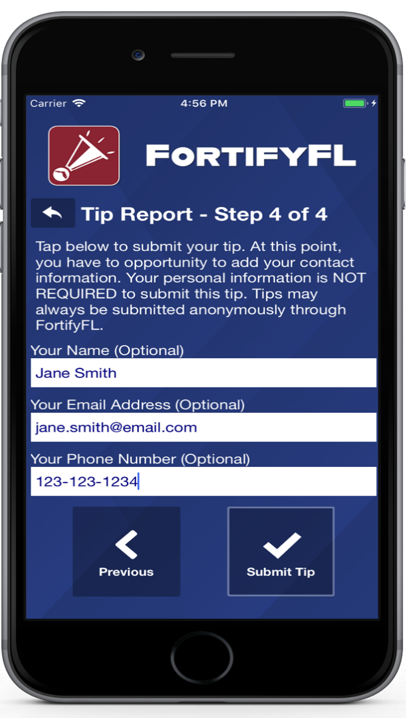
HOW DO I SUBMIT A TIP?
Step 4: Provide Optional Information and Submit Your Tip

Slide 29
False Tips Lead to possible Criminal penalties
If someone who knowingly submits a false tip through FortifyFL may be subject to further investigation by law enforcement, and may be subject to criminal penalties under Section 837.05, F.S.

Slide 30


Slide 31
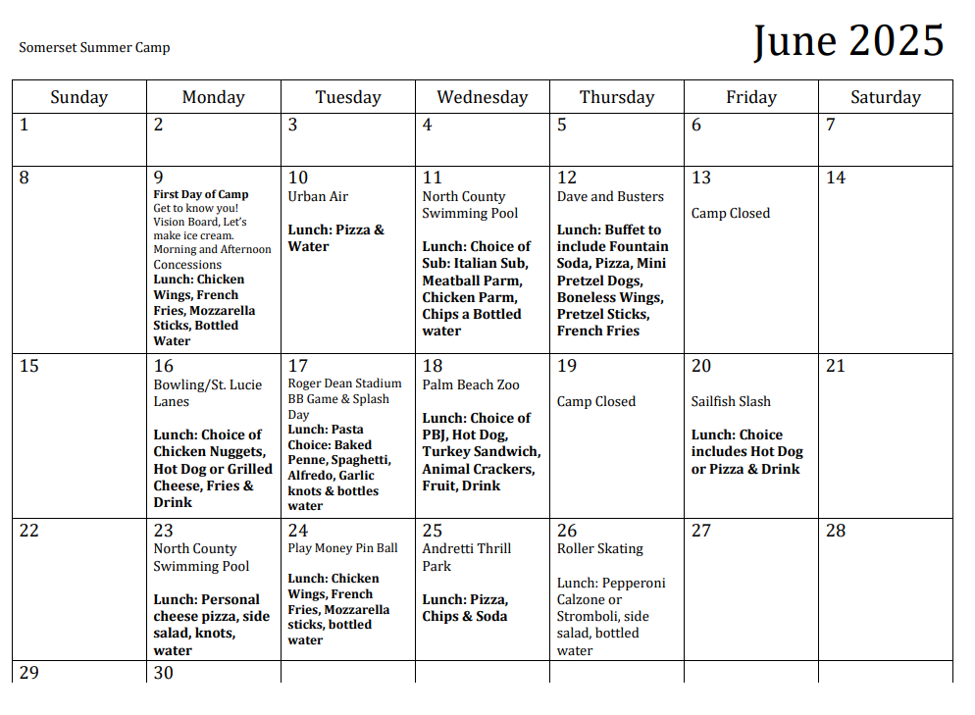

Slide 32
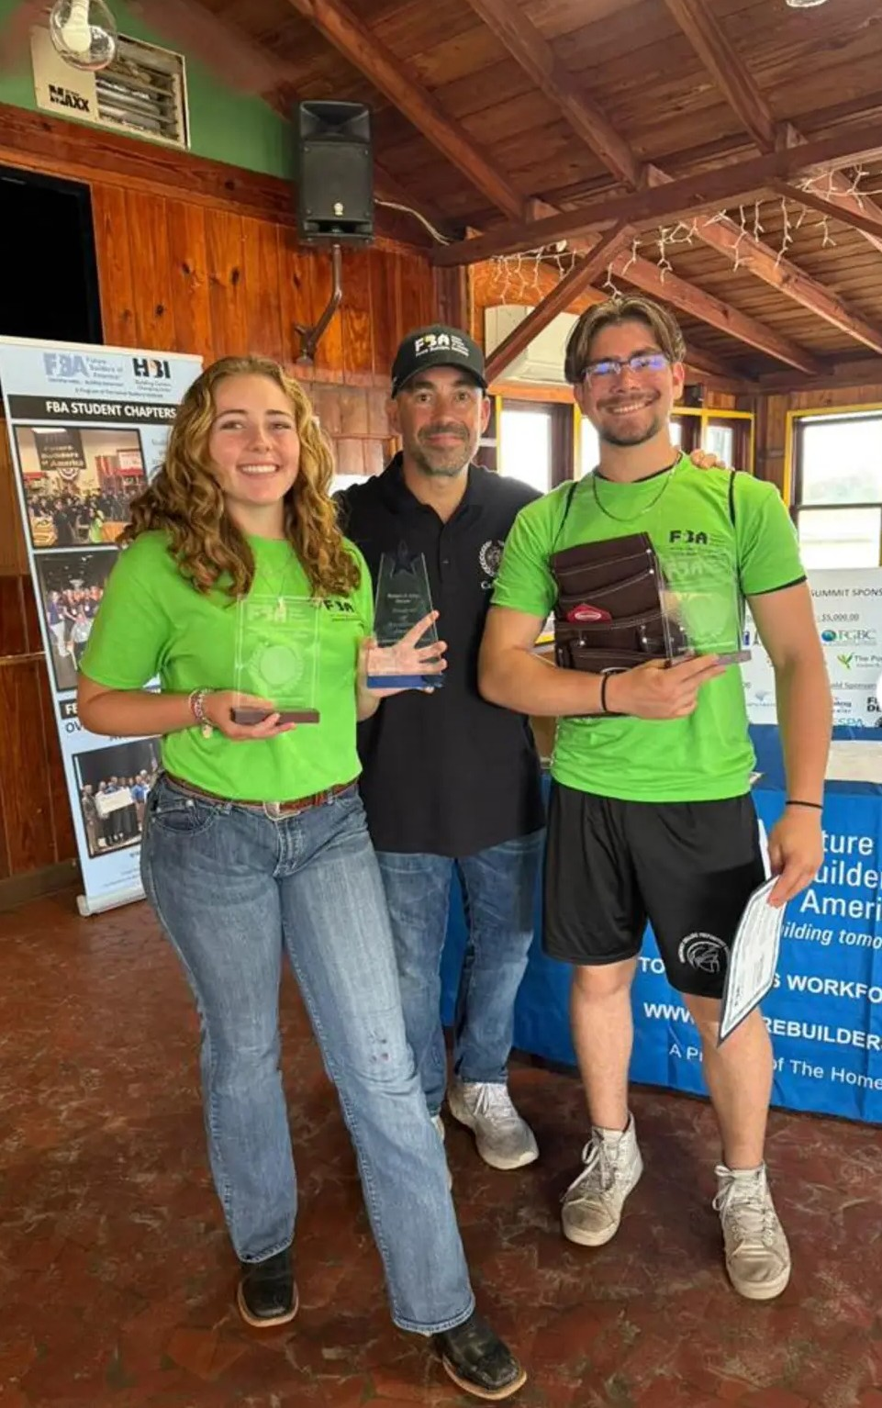
FBA Leadership Summit
Another year of the FBA Leadership Summit has come to an end. Seventy-five students from around the state participated.
Countless contractors, community leaders, teachers, and administrators come together every year to expose students to over a dozen different trades providing opportunities for hands on experience.
Somerset Career Academy's Eric Seda won his team's leadership award.
Ocean Prettelt from Somerset College Prep. won the Harper Leadership Award for the entire summit!

Slide 33


Slide 34

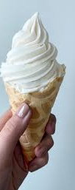
Effective Wednesday April 23
Ice cream can only be purchased with the purple (fast pass) card.
That card can be purchased in either the breakfast or lunch lines at the register.
Ice cream sales will NO longer accept your lunch number or cash to get your ice cream.
ALL ice cream must be pre-purchased prior to coming to make your selection. NO exceptions!

Slide 35

if the wrappers from ice cream sales continue to be dropped/thrown on the floors or the sidewalks or the turf, ice cream sales will be stopped immediately.
Our janitorial staff is not here to clean up your lazy mess after you enjoyed a cold treat.
Wrappers go in a trash can, or you will lose the ice cream!

Slide 36


Slide 37


Slide 38
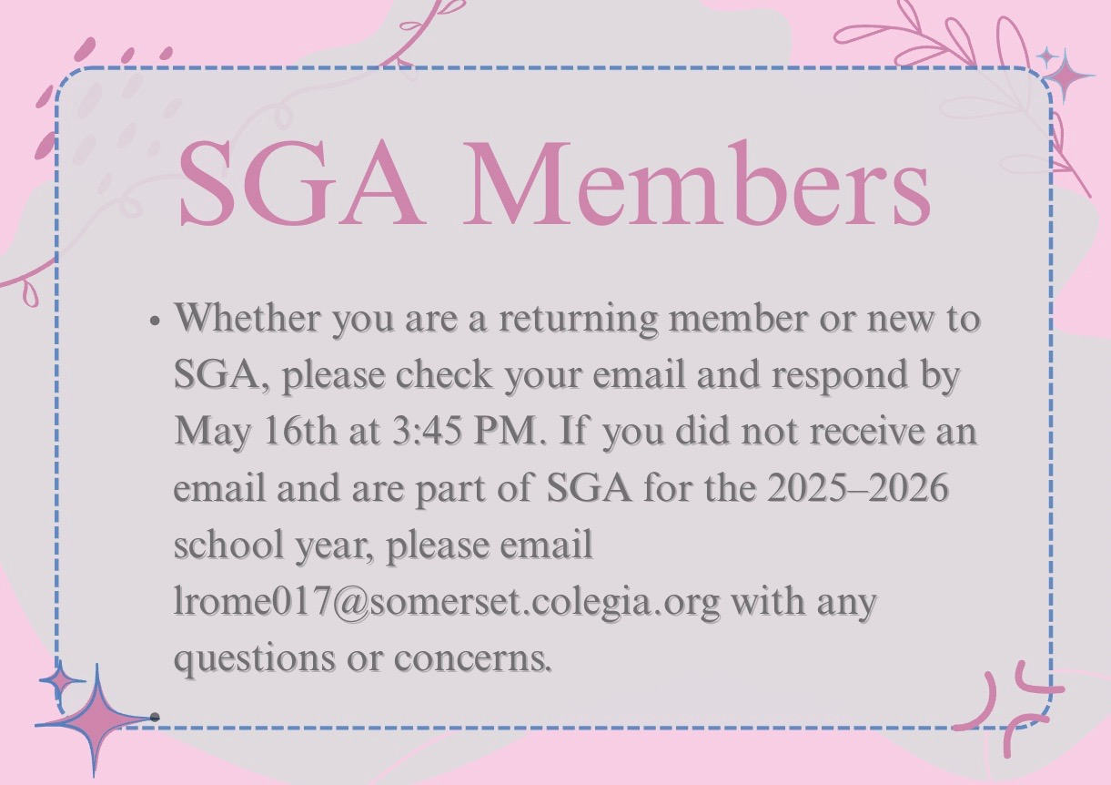

Slide 39


Slide 40
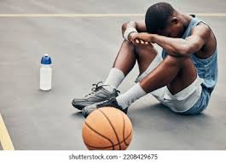
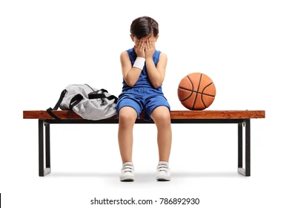
If you paid to be apart of the NBA 2K tournament that was supposed to take place during the 1st semester (but never did), please see Ms. Walker in 209 for a refund (It’s upstairs next to 205; you have to ring the door bell)

Slide 41










Field Day is on
May 30th!!
ATTENTION STUDENTS!!!
SGA IS SELLING
FIELD DAY TICKETS!!!
MAY 5 - MAY 16
TICKETS MUST BE PURCHASED ONLINE AT THE SCHOOL STORE
PERMISSION SLIPS MUST BE TURNED IN AT LUNCH (LOCATED IN THE SPILL OUT)
Cost: 15 Dollars
Includes Your Ticket Includes: 2 Slices of Pizza, 1 Bottled Water, 1 Bag of Chips, 1 Kona Ice
Get Ready for: Inflatable Obstacle Course, Dunk Tank (1 throw = $1, not included in ticket), Movie Room, Inflatable Jousting
... and so much more!

Slide 42

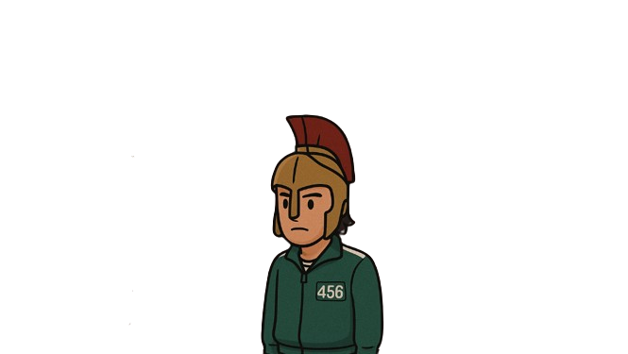
SCPA SGA Presents to you:
SPARTAN GAMES
Date: 5/30/25
Time: 9:00 – 1:30
LOTS OF GAMES! (Kick ball, dodge ball, Red light – Green light, Musical chairs, etc.)
Also, multiple inflatables to enjoy with friends as well as food, music, and more!

Slide 43


Slide 44



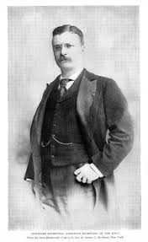


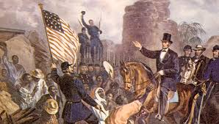
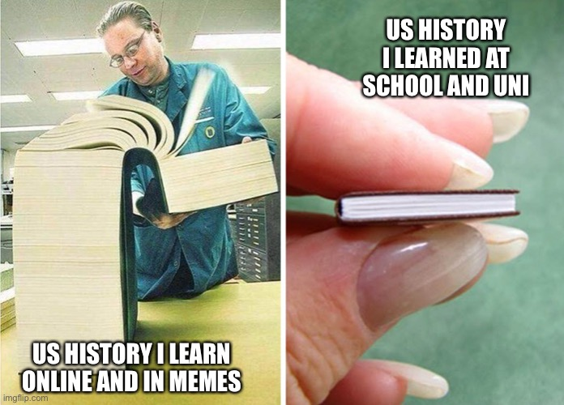
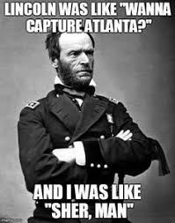

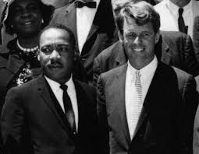

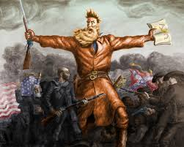


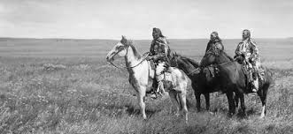
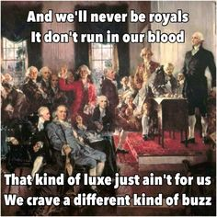
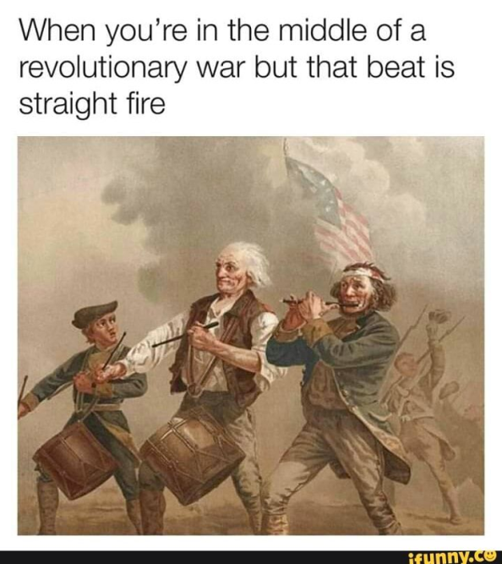
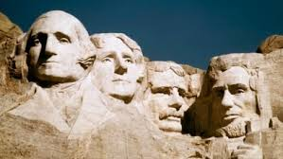

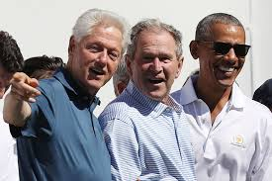
Mr. Kyryliw’s US History EOC Prep Sessions
May 15th Thursday 4-5pm
May 16th Friday: US History EOC- Good luck!

Slide 45


Marsh's Civics EOC Prep
Thursday 5/15 Final ZOOM Prep
7pm -9pm

Slide 46


Slide 47


D&D Club
Come join the adventure
Mondays
3:50 to 5:15
Rm.# 175

Slide 48
School Clubs
Mondays
-Chorus- High School. Afterschool from 4-5:30 in 268C
-Band- Middle School. Afterschool from 4-5:30 in 271C
-Guitar Club- Afterschool from 4-5 pm in 169C
-Dungeons and Dragons- Afterschool, from 3:50-5:15 in 175C
-Movie Club- At Lunch in 234A
-Boxing Club- Outside on the turf afterschool, on Mondays, Wednesdays, and Fridays
Tuesdays
-Florida Future Educators of America (FFEA)- At lunch in 164C
-Artists for a Cause- Tuesdays at lunch in 268C and 2nd Wednesday of the month
-Korean and Japanese Popular Music- At lunch in 230A
Wednesdays
-Student Government Association (SGA) –Afterschool in 226A
-First Priority- At lunch in 263C
Thursdays
-Future Builders of America- At lunch, in 175C
-Chorus- Middle School. Afterschool, 4-5:30 in 265C
-Band- High School- Afterschool from 4-5:30 in 271C
Fridays
-Chess Club- At lunch, in 234A
--Students Working Against Tobacco (S.W.A.T)- At lunch, in 168C Every other Friday

Slide 49
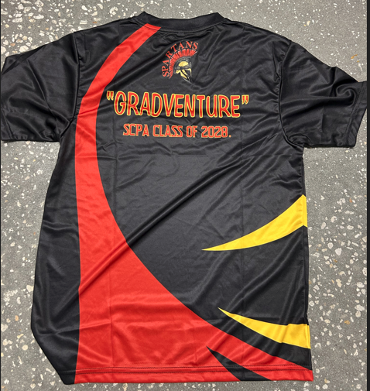
Free Gradventure Shirts
Class of 2028 ( 9th grade) ONLY
Interested!
Email Mr. Horne with your size.
(Use School email) Horne.David@somersetcollegeprep.org
All sizes available. All shirts must go.

Slide 50

Interested in starting a school club?
If you’re interested in starting a school club, you should do the following:
  Find a teacher to sponsor the club. Give them the details about the club so they know if they’re able to sponsor the club.
  Create a petition and get students who would be interested in your club to sign it. This shows that your club has generated interest.
  Talk to someone in administration about getting your club approved. Tell them who the sponsor is, when the club will occur (lunch or afterschool), and what the club entails.
  Email Mr. Kyryliw (Kyryliw.Michael@somersetcollegeprep.org) the information about you club and a slide advertising it. I will leave the advertising slide up for a week or so and create a slide listing all the club information for easy reference.

Slide 51
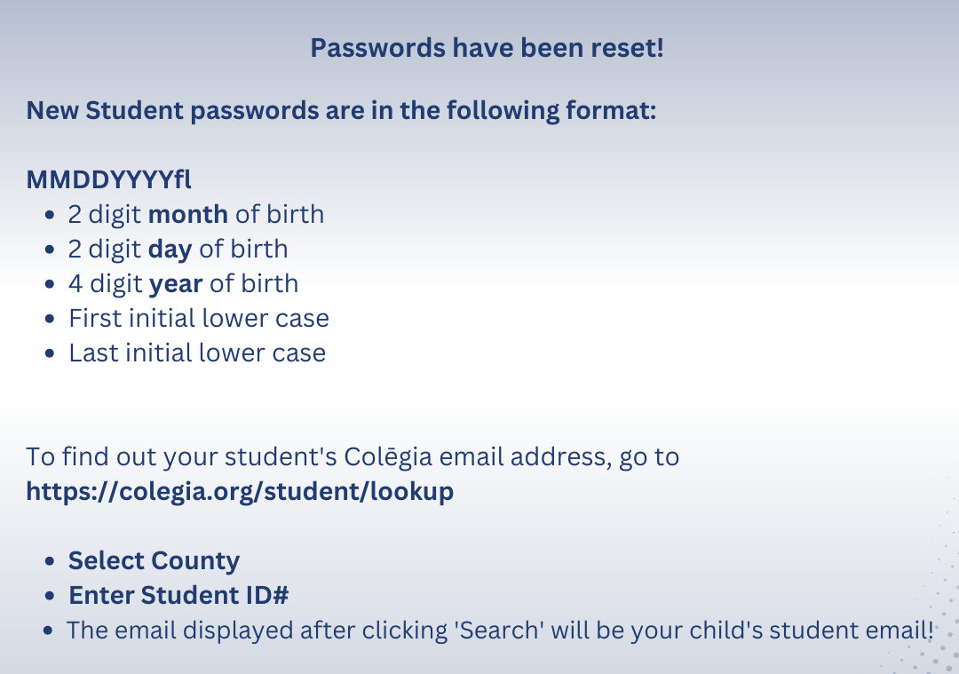

Slide 52


Somerset College Prep &Public Wireless ACP Program
This document will also be in the front office for you to scan the QR code.

